Slide 1
Equity-based Decision-Making for Health
Ben Fredrick, MD
Director, Pennsylvania Area Health Education Center (PA AHEC) and its PA Training Center for Health Equity
Notes:
No conflicts of interests to disclose.

Slide 2
Notes:
A fundamental mistake that produces inequitable results and processes is in decision-making that treats everyone the same (equality approach), taking no account of important differences that will have bearing on the ability of certain groups of people to take advantage of the opportunity in a fair way (equity approach).
There is actually a lot we can learn from this picture if we take time to really consider it. Consider what had to happen for the picture to shift from the top frame to the lower frame. Someone had to notice that the same solution was not working well for some people. Some using the bikes were at increased harm because the bike wasn't right-sized. One couldn't even ride a bike. While the system of producing bikes was efficient, it was not effective. Decision-makers had to innovate and redesign, not only different sized bikes, but a very different bike in order that all would have opportunity.
This illustrates that things can change—and we have to believe this if we are going to pursue health equity—and that in order for them to change we need to make decisions that account for people who tend to be left out. We need to design our processes, protocols, and programs with these people in mind.

Slide 3
How does this map illustrate health equity decision-making?
Notes:
This is a map of a rural county in Haiti. The red boxes represent villages. The local health organization set an outreach goal of reaching the furthest child in the furthest village—the ones most likely to be left behind due to time and resources. When the leadership found through regular monitoring that they were not reaching all the children in the timeframe they established, they decided to purchase motorcycles for their workers so that the workers could reach the children along the roads much faster, leaving more time for the workers to walk up into the mountains to reach the furthest child in the furthest village. And they succeeded in reaching all 10,000 children as a result… because they monitored their progress and adapted until their goal was achieved.

Slide 4
How did this hospital apply health equity decision-making?
Notes:
Prior to opening a new hospital an art acquisition process was initiated which involved a committee of diverse participants who were able to identify exclusionary processes in prior art acquisition methods and create a new process that was more inclusive. The upshot of the changes were as follows:
Eligibility criteria were changed (e.g., artist not required to have had gallery exhibits, which was a deterrent to some artists)
Language was changed to be more legible to people outside of academia
An easier-to-navigate application process was developed
A support system for the application process was implemented
These changes led to an incredibly diverse and more welcoming and inclusive atmosphere there. According to hospital leadership, a “palpably different art collection” for the new hospital compared with other hospitals owned by the health system.

Slide 5
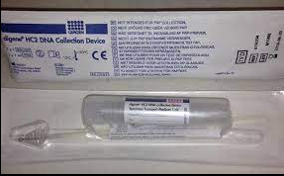
What does this pap screening kit have to do with health equity decision-making?
Notes:
A 46-year-old female consistently refused a pap smear. In discussing these refusals with the patient, the doctor learned that she had been traumatically abused in her adolesence. The doctor suggested self-pap screening, which the patient agreed to do. This approach adapted to the need and reduced the likelihood that this woman would be left unscreened for cervical cancer.

Slide 6
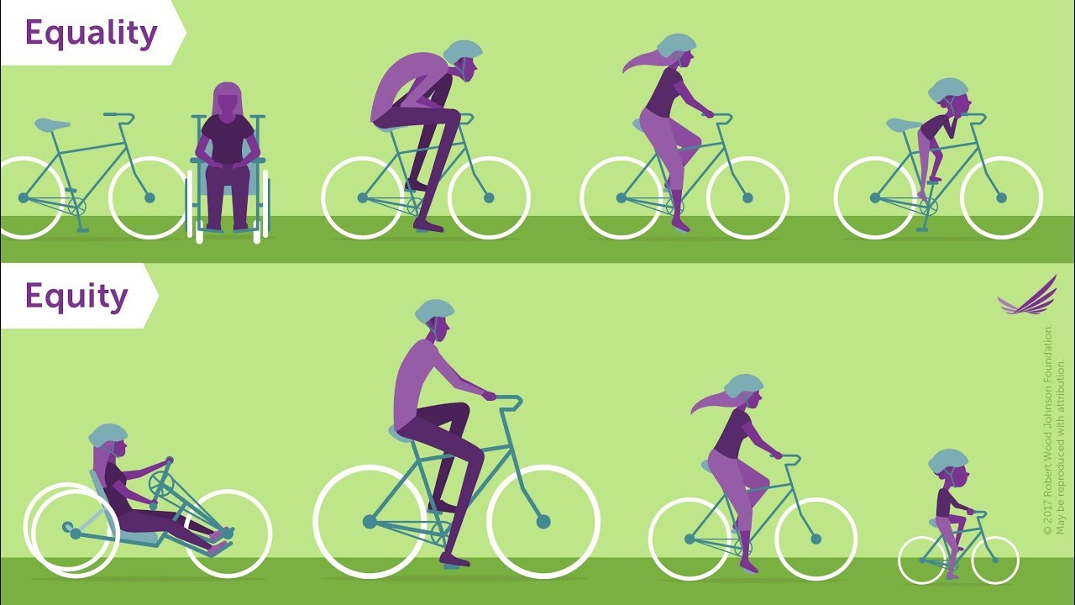
What do these examples have in common?
Equity-based decision-making: Seek the highest level of opportunity for all
Avoid equal, common universal approaches (equality approach = same bike for everyone)
Proportionate response based on need
Customized and innovated solutions
Intentionally include historically disadvantaged groups and voices
Develop a habit of mind: Who is being left out in this?

Slide 7
Health Equity Planning Tool
 | Socially vulnerable populations | Potential impacts and rationale | Mitigation possibilities | Monitoring plan
Place (geography)
Religion
Occupation
Gender
Race/ethnicity
Educational attainment
Socioeconomic status
Stigma (e.g. disability, LGBTQ, age, etc.)
Notes:
Here is one possible approach to consider as you make decisions, begin new protocols, processes, programs, or want to review ongoing ones. It uses the acronym PROGRESS.
Left-hand side: some common categories for discrimination. In the next column you will Identify historically disadvantaged or vulnerable groups in your own context, among the people you are serving, including employees. Then consider what impacts the decision might have on these groups and brainstorm mitigation possibilities. Consider including people who represent some of these vulnerable groups to participate in your decision-making processes to provide their unique perspectives. Finally—like the group focused on child health outreach in Haiti—have a way to monitor the impact on these particular groups and continue to modify as needed.

Slide 8
Resources
Healthequityguide.org
Health equity lens (Minnesota)
Multnomah Equity and Empowerment Lens
Robert Wood Johnson Foundation and health equity
PROGRESS Tool (to help identify groups a priori)
Place
Religion
Occupation
Gender
Race/ethnicity
Educational attainment
Socio-economics
Stigma
Notes:
A few resources you may find useful in thinking about health equity-based decision-making.

Slide 9
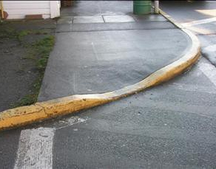
Thank you!
Notes:
Equity-based decision-making requires innovation. And it can be hard to see a need unless one is really paying attention, or is aware of the need.
What are the curb-cut outs that may need to be built into your organization?

